Slide 1
SWE30003
Software Architectures and Design
Lecture 12
Summary of Main Concepts,
Final Assessment Info
Notes:
SWE30003 Software Architectures and Design
S1 2023
© Swinburne University of Technology

Slide 2

Outline
Summary of Main Concepts
Information about Final Assessment (Online Test)
Notes:
SWE30003 Software Architectures and Design
S1 2023
© Swinburne University of Technology

Slide 3
Major Topics covered this semester
Requirements Analysis and Specification
Object Oriented Design
Software Architecture Design

Slide 4
Communication of information is
the key concept behind a
requirements specification!
In fact, this applies to any document produced in the SDLC!!
Notes:
SWE30003 Software Architectures and Design
S1 2023
© Swinburne University of Technology

Slide 5
Who is the intended Audience?
The Goal Design Scale for software requirements - The intended audience will determine which of the following levels is/are most appropriate:
Goal
Domain
Product
Design
Questions:
What do you do if the audience is mixed?
What is the purpose of the SRS?
Notes:
SWE30003 Software Architectures and Design
S1 2023
© Swinburne University of Technology
Comment: may be worth remembering these four levels and some sample requirements each…

Slide 6
The Goal-Design Scale (cont.)
(Ship repair quotation system)
R1. Our pre-calculations shall hit within 5%
R2. Product shall support cost recording and quotation with experience data
R3. Product shall have recording and retrieval functions for experience data
R4. System shall have screen pictures as shown in app. xx
Goal-level
requirement
Domain-level
requirement
Product-level
requirement
Design-level
requirement
Which requirement to choose?
If the supplier is
A vendor of business applications?
A software house - programmers?
PriceWaterhouseCoopers?
Notes:
SWE300003 Software Architectures and Design
S1 2023
© Swinburne University of Technology
… and maybe it is worth noting “traceability” here…

Slide 7


Types of Requirements
Quality reqs:
Performance
Usability
Maintainability
. . .
Other deliverables:
Documentation
Install, convert,
train . . .
Interfaces
User
groups
Platform:
Hardware, O/S
Sensors, Actuators
System
No Size Fits All!
Ext. products:
3rd Party Software, Database
Data requirements:
System state: Common states,
Input/output formats, Persistent Data
Managerial reqs:
Delivery time
Legal
Development
process . . .
Helping the reader:
Business goals
Definitions
Diagrams . . .
Functional requirements, each interface:
Record, compute, transform, transmit
Theory: F(input, state) -> (output, state)
Function list, pseudo code, activity diagrams
Screen prototypes, user tasks
Notes:
SWE30003 Software Architectures and Design
S1 2023
© Swinburne University of Technology
This slide probably needs quite a bit of explanation…

Slide 8
Capture Functional Requirements: Tasks & Support
Task: 1.2 Checkin
Purpose: Give guest a room. Mark it . . .
Frequency: . . .
Sub-tasks:
1. Find room.
Problem: Guest wants neighbour rooms; price bargain.
2. Record guest as checked in.
3. Deliver key.
Problem: Guest forgets to return the key; guest wants two keys.
Variants:
1a. Guest has booked in advance.
Problem: Guest identification fuzzy.
Example solution:
System shows free rooms on floor maps. System shows bargain prices, time and day dependent.
(Standard data entry)
System prints electronic keys. New key for each customer.
System uses closest match algorithm.
Past:
Problems
Domain
level
Future:
Computer part
From: Soren Lauesen: Software Requirements © Pearson / Addison-Wesley 2002
Notes:
SWE30003 Software Architectures and Design
S1 2023
© Swinburne University of Technology

Slide 9
Identify Quality Attributes?
Identify the top 3 to 5 quality attributes/factors of the domain
  Assume that qualities of similar applications will also be of relevance for the application under consideration
Systematically go through all identified user task
  Identify these tasks that make explicit mention of the identified quality attributes
  Note: “critical” of user tasks generally imply qualities!
Spell out the resulting non-functional requirements in a verifiable form.
Maybe not be 100% perfect, but a good start…

Slide 10
Function vs. Quality
Many requirements have both functional and quality aspects.
Example: “Halt garage door within 0.5 seconds when an obstacle is detected.”
  Function: detect obstacle, halt garage door
  Quality: within time limit (0.5 seconds)
Notes:
SWE30003 Software Architectures and Design
S1 2023
© Swinburne University of Technology

Slide 11
Quality Criteria for Requirements
Correct: each requirement reflects a need
Complete: all necessary requirements are included
Verifiable: possible to see whether is/can be met
Ranked for importance/stability: priorities
Understandable by customer and developers

Slide 12
General View of Abstraction
Real World
Phenomenon with messy details
Facts and laws governing the real world
Abstract World
Model with “simple” properties
Representation subject to “formal” manipulation
Abstraction: mapping from real world to abstract world

Slide 13
Software Abstractions
Abstraction is the most important concept in computer science (and probably also the oldest):
  any kind of software generally consists of several layers of abstraction.
A software abstraction has two levels:
  Specification (i.e. what it offers to clients)
  Realization (i.e. the lower-level building blocks used to support the specification)
Notes:
SWE30003 Software Architectures and Design
S1 2023
© Swinburne University of Technology

Slide 14
Software Abstractions (cont.)
Software Architectures
Subsystems
Components
Modules, Packages
Objects, Interfaces
Abstract Data Types
Functional abstractions (i.e. procedures)
Primitive data types
Simple arithmetic expressions and control structures
Macros
Symbolic names (for instructions and memory cells)
Machine instructions, memory cells
“high-level”
“mid-level”
“low-level”
Notes:
SWE30003 Software Architectures and Design
S1 2023
© Swinburne University of Technology

Slide 15
What is an Object?
knows
information
performs
computations
Processing
Object
Interaction
Composition
maintains connections
(to other objects)
can be composed
(as part of other objects)
Notes:
SWE30003 Software Architectures and Design
S1 2023
© Swinburne University of Technology
… and then get away with the notion of an Object in the middle – let’s call it a “Processing Element”…
… and one can already highlight the notion of “Separation of Concerns”

Slide 16
Class Responsibility Collaboration Cards
Use CRC cards to record candidate classes:
Record the candidate Class Name and superclass (not yet known)
Record each Responsibility and the Collaborating classes
  compact, easy to manipulate, easy to modify or discard!
  easy to arrange, reorganize
  easy to retrieve discarded classes
Text Creation Tool subclass of Tool
Editing Text
Notes:
SWE30003 - Software Architectures and Design
S1 2023
© Swinburne University of Technology
Need to explain in more detail what a CRC card is… and what it is good for!
Also worth noting that we should not prematurely identify class hierarchies!

Slide 17
Object-Oriented Applications
An application = a set of interacting objects
An object = an implementation of one or more roles
A role = a set of related responsibilities
A responsibility = an obligation to perform a task or know certain information
A collaboration = an interaction of objects or roles
Notes:
SWE30003 Software Architectures and Design
S1 2023
© Swinburne University of Technology

Slide 18
Abstract State vs. Concrete State
Every object (bar a few rare exceptions) contains statefull information (an object has state).
Externally visible properties of this state defines its abstract state
  Stack: size, order of elements, top element
Internal representations define the concrete state
  Stack may use a list or array to “store” its elements
Clients should only ever rely on an object’s abstract state, not its concrete state.
Object equality should only ever be defined over the abstract, but never on the concrete state.
Notes:
SWE30003 Software Architectures and Design
S1 2023
© Swinburne University of Technology
I think I need to give an example or two the characterizes the difference between abstract and concrete state…

Slide 19
What are Patterns?
“Patterns describes a problem which occurs over and over again in our environment, and then describes the core of the solution to that problem, in such a way that you can use this solution a million times over, without ever doing it the same way twice.”
— Alexander et al., A Pattern Language, 1977
Notes:
SWE30003 Software Architectures and Design
S1 2023
© Swinburne University of Technology
I can reiterate the notion of patterns in design and why they are important…

Slide 20
Software Architecture
The architecture of a software system is described as:
the structure(s) of its high-level processing elements,
the externally visible properties of the processing elements, and
the relationships and constraints between them.
in other words:
The set of design decisions about any system (or subsystem) that keeps its implementors and maintainers from exercising “needless creativity”.
Notes:
SWE30003 Software Architectures and Design
S1 2023
© Swinburne University of Technology
Also: the set of design decisions that are the hardest to change…
NOTE: this slide has evolved over time… added the notion of “high-level”…

Slide 21
Architectural Styles
“An architectural style defines a family of software systems in terms of their structural organization. An architectural style expresses components and the relationships between them, with the constraints of their application, and the associated composition and design rules for their construction.”
— Dewayne Perry and Alexander Wolf, 1992
Notes:
SWE30003 Software Architectures and Design
S1 2023
© Swinburne University of Technology

Slide 22
Popular Architectural Styles
Data-flow architectures:
  Batch sequential, Pipes-and-Filter
Call-and-Return architectures:
  Main program and subroutine, Object-oriented
  Layered
  Client-Server
Data-centred architectures:
  Repository, Blackboard
Independent component architectures:
  Peer to Peer
  Communicating processes
  Event systems: implicit invocation, explicit invocation
Virtual machine architectures:
  Interpreter, rule-based systems
Service oriented architecture:
  Software services, WS*(SOAP) Web services, REST services, Microservices
Notes:
SWE30003 Software Architectures and Design
S1 2023
© Swinburne University of Technology
This is only a brief overview of common architectural styles

Slide 23
s/Object/Processing Element/g
(Almost) everything that applies to objects can be used at higher levels of abstraction!
[Modules, Components, Sub-Systems …]
Notes:
SWE30003 Software Architectures and Design
S1 2023
© Swinburne University of Technology

Slide 24
Separation of Concerns
Processing
(“Components”)
Deployment
Interaction
(“Connections”)
Composition
(“Hierarchies”)
Notes:
© Swinburne University of Technology,
Faculty of Information and Communication Technologies
The same set of processing elements with the same interactions can be deployed differently and result in different kind of system qualities!!

Slide 25
C&C vs. Deployment
Component and Connector:
  Focus on (run-time) computational entities (i.e. components, processing elements) and their means of communication (i.e. connectors).
  What are the main executing components and how do they interact?
Allocation, Deployment:
  Focus on computational entities and their (physical) environment.
  What processing node does each component execute on?
Notes:
SWE30003 Software Architectures and Design
S1 2023
© Swinburne University of Technology
In the conext of this unit, we are particularly focusing on C&C and allocation views!

Slide 26
“Notation used?”
Notes:
I will reserve the right to disregard any graphical notations in Assignment 3 if the the notation used is unknown…
SWE30003 Software Architectures and Design
S1 2023
© Swinburne University of Technology

Slide 27
Important to consider
Various design factors determine how to approach the design of a large-scale software system,
Abstraction is the most important concept in software,
Quality attributes, not functional requirements, determine the main design decisions.
Patterns and Architectural tactics assist in addressing quality attributes in designs!
Tactics require a certain level of experience to use them effectively,
Up to system designer to decide when and how to use what kind of tactics and/or patterns.
Software development is “always” reuse driven!
Pattern-based reuse vs code reuse!
Notes:
SWE30003 Software Architectures and Design
S1 2023
© Swinburne University of Technology

Slide 28
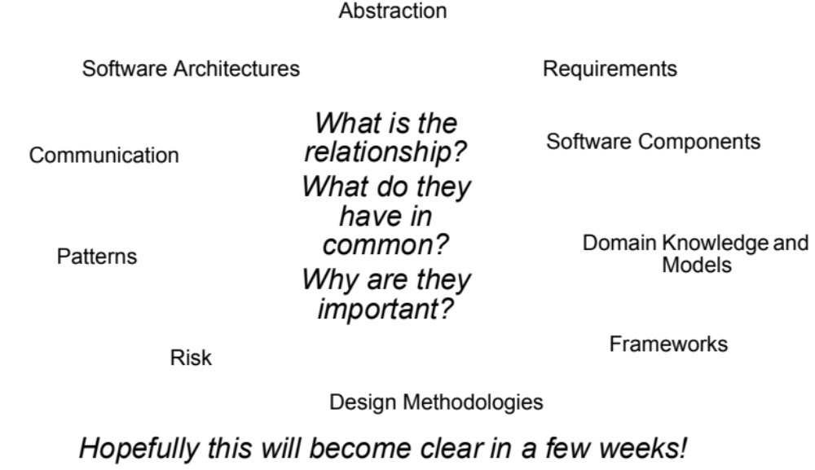
To think about…
Validation & Verification
Decomposition
Notes:
SWE30003 Software Architectures and Design
S1 2023
© Swinburne University of Technology
A mental model of how these concepts are related should now emerge…

Slide 29
“Vocabulary” for System Design
Software architectures, patterns, software components, etc.:
are all “ingredients” for (large-scale) system design,
define a vocabulary to enhance communication amongst the different stakeholders of a system,
increase level of abstraction,
enable system design at various levels of abstraction,
enable encapsulation of system concerns into self-contained, reusable entities.
Notes:
SWE30003 Software Architectures and Design
S1 2023
© Swinburne University of Technology

Slide 30

… but think the problem through!!

Slide 31


Slide 32
Outline
Summary of Main Concepts
Information about Final Assessment (Test)
Notes:
SWE30003 Software Architectures and Design
S1 2023
© Swinburne University of Technology

Slide 33
Information about Test
Online on Canvas
Date: Wednesday, 7 June 2023
  2.5 hours from 2pm (AEST).
  Normally, should be able to answer all questions in < 2 hours.
Worth 20% of your final mark
Open book, but your own work/words (ie, no consultation, no chapGPT/tools, no discussion with others)
More specific info will be announced in week 13 …
Topic: all material covered during lectures (but not necessarily in the notes! … readings etc!), tutorials and three assignments (unless indicated otherwise).
No really “tricky” or difficult questions, but ~ weekly questions!
Notes:
SWE30003 Software Architectures and Design
S1 2023
© Swinburne University of Technology

Slide 34
Information about Test (cont.)
Main focus: being able to apply knowledge in a problem situation.
In general, extended-answer questions,
  About software requirements
  About OO design
  About architecture design (more)
Best preparation:
  having seriously done all assignments & all parts,
  done all required readings,
  practiced writing answers each week,
  actively participated in tutorials. (Note that marks given for weekly answers do not represent full appreciation of the questions …)
Do not memorize answers to “sample” questions!!!
– no “standard” answers (not provided)
Notes:
SWE30003 Software Architectures and Design
S1 2023
© Swinburne University of Technology

Slide 35
Consultation & discussion before Test
** The following consultation sessions (via Collaborate on Canvas) are indicative, and subject to change:
  4:15pm-5:15pm, Wednesday 31 May 2023;
  2:30pm-3:30pm, Friday 2 June 2023;
  2:30pm-3:30pm, Monday 5 June 2023;
  4:15pm-5:15pm, Tuesday 6 June 2023.
  or, by email appointment
In any case, please send me an email when you intend to come to a consultation – indicating approx. time!
** Use discussion forum on Canvas …
Notes:
SWE30003 Software Architectures and Design
S1 2023
© Swinburne University of Technology

Slide 36
Sample Exam Questions: Requirements (I)
Software requirements can be described at four levels. Name these four levels and give an example requirement for each.
Using six sentences, summarize the importance/relevance of a software requirements specification (SRS) in the software development lifecycle (SDLC).
In your own words, explain the difference between functional and non-functional requirements and give a sample requirement for each.
In your own words, characterize the concept of software quality and give two examples why specifying software quality generally is a non-trivial task.
Notes:
SWE30003 Software Architectures and Design
S1 2023
© Swinburne University of Technology

Slide 37
Sample Exam Questions: Requirements (II)
What are the main differences between a reliable and a robust software system?
List the major topics which you would expect to find covered in a good requirements specification.
“The system shall exhibit acceptable performance.” This is an example of a common non-functional requirement. Why is this not an acceptable requirement, and how can it be modified to make it better?
Why is it important to make the distinction between the inner domain and the outer domain? When in the Software Development Lifecycle would you need this information?
Notes:
SWE30003 Software Architectures and Design
S1 2023
© Swinburne University of Technology

Slide 38
Sample Exam Questions: Design (I)
The principle of information hiding is generally regarded as a good design principle and has been successfully applied in many software systems. However, there are design situations where hiding information is not a good choice. Under which circumstances is information hiding appropriate and under which might it not be recommended?
Does the data-flow architectural style provide support for portability? If so, how? If not, which architectural styles do?
What role does the concept of Software Architecture play in increasing the quality of a system’s design and accommodate non-functional requirements?
Notes:
SWE30003 Software Architectures and Design
S1 2023
© Swinburne University of Technology

Slide 39
Sample Exam Questions: Design (II)
A project leader asks you to come up with reference implementations for a given set of design patterns. From a technological point of view, what is the appropriate answer to this demand? Explain!
Explain how a good object-based decomposition of a given problem results in weak coupling and strong cohesion? When will an object-based decomposition result in strong coupling?
What are the advantages and disadvantages of a “data-centric architectural style”? For what kinds of projects/problem scenarios is it appropriate to use this style?
Notes:
SWE30003 Software Architectures and Design
S1 2023
© Swinburne University of Technology

Slide 40
More Sample Questions …
See
weekly questions,
tutorial questions
Any Questions?
Notes:
SWE30003 Software Architectures and Design
S1 2023
© Swinburne University of Technology

Slide 41
Best wishes for the Test!!
Notes:
SWE30003 Software Architectures and Design
S1 2023
© Swinburne University of Technology

